Slide 1
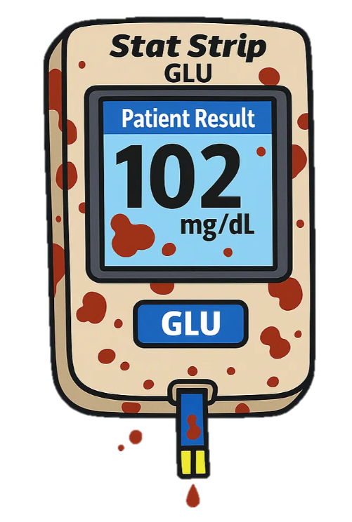

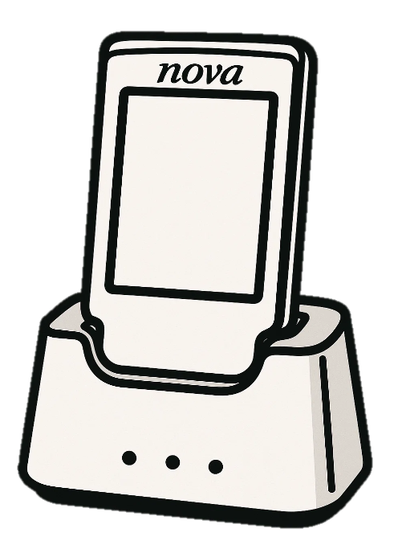

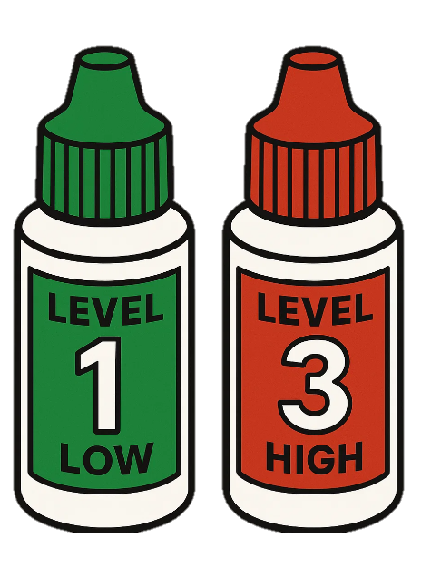

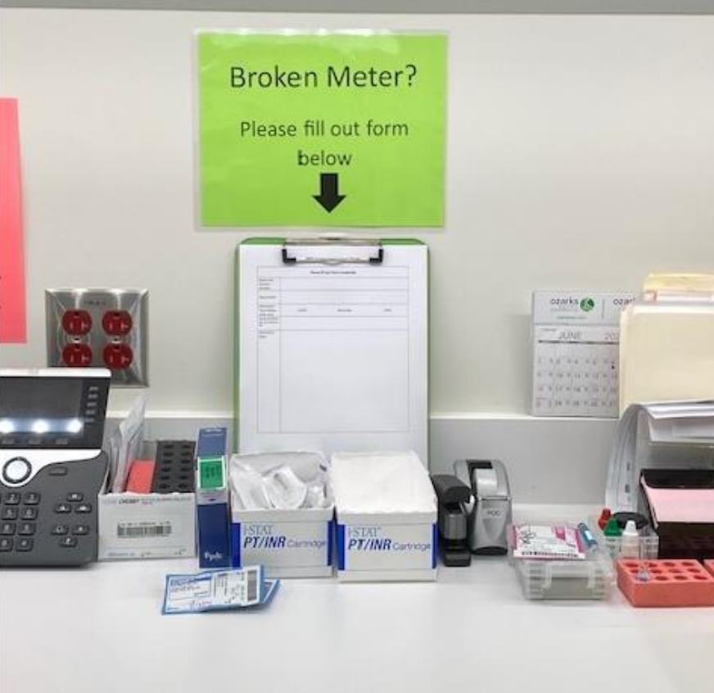
Nova StatStrip Glucometer Tips
Use Bleach Wipes
Clean Meter
Wet Time: 4 Minutes
Front and back
3 swipes horizontally
3 swipes vertically
Use additional bleach wipes to keep wet for 4 minutes
Alcohol wipe to remove white residue.
Do Not Dock until 4 min wet time is complete!
Between each patient.
Date All Opened Vials And Strips
6 months after opening (or until printed expiration date)
3 months after opening (or until printed expiration date)
Do not enter a Biomed Ticket for a broken glucometer.
Follow these steps:
Hand carry the meter down to the POC Office.
Room 1408, 1st Floor, New Tower, Patient Discharge Hallway (Lab)
Fill out the instrument issue form.
Leave the broken glucometer and filled out form on tall counter.
Broken Glucometer?
POC Contact Info
Office number: (479) 338-2844
ROGRRGMercyPOC@mercy.net

